Slide 1
Gartner Magic Quadrant + Critical Capabilities
Enterprise Agile Planning Tools

Slide 2
Agenda
EAP Market Future in 2023 (10 mins)
Marketing & Positioning (5 mins)
Executing on Vision (5 mins)
Critical Capabilities (20 mins)
  Backlog Management
  Scrum Team Support
  Program / Portfolio level planning and tracking
  Integration with 3rd party Agile Planning Tools
  Visibility to stories through the DevOps toolchain
Use Cases (20 mins)
  Mixed Methodologies
  Outsource

Slide 3
The Future of Enterprise Agile Planning
What do you think the EAP tools market will look like in 2023?

Slide 4
First, Consider the Tenets of Agile
Individuals and interactions over processes and tools
Working software over comprehensive documentation
Customer collaboration over contract negotiation
Responding to change over following a plan
Enterprise Agile Planning has these challenges:
  Computers will be writing more of the code
  Rules and regulations will demand documentation
  Outsourced, freelancer economies redefine “customer”
  Investments at the program level need plans
So how do you remain agile and support the enterprise?

Slide 5
What will the world look like in 2023?
Developers will be using different tools and frameworks than they do today.
Machine learning and AI will be part of many software projects.
Requirements will describe models that get refined by feedback and coded by computers
Users will be using different interfaces at work – watch, glass, touch, IOT, HUD, VR, etc.
Clouds and systems will be partitioned to address data privacy and regulatory constraints
We will still have human testers, designers, engineers and managers

Slide 6
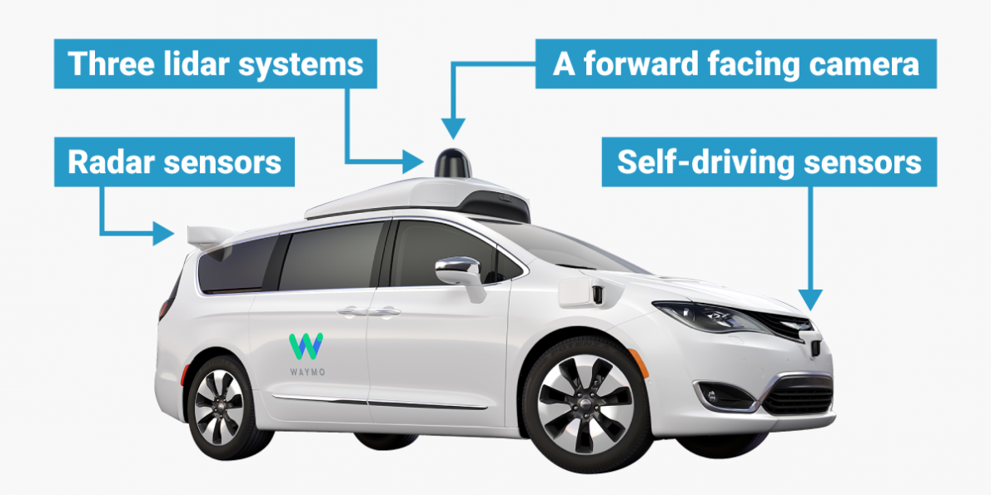
Example 1: Self-Driving Vehicles
Image, courtesy of Waymo, BusinessInsider.com
Significant amount of safety & quality documentation (ISO 26262)
Embraces agile methodologies with regulatory oversight
Machine-learning algorithms, high-level user “requirements” tied to self-learning feedback loop
Melding of hardware and software components, external interfaces
Security built into lifecycle (SecOps)

Slide 7

Example 2: Healthcare IT Systems
Enterprise Program Project
Data Data Data
Data privacy and compliance rules at the project team level
Need to federate data between project, program and enterprise
Ability to isolate HIPAA, PHI data from management data
Strong audit ability, electronic signatures and traceability
Agile approach in between specific regulated phases

Slide 8
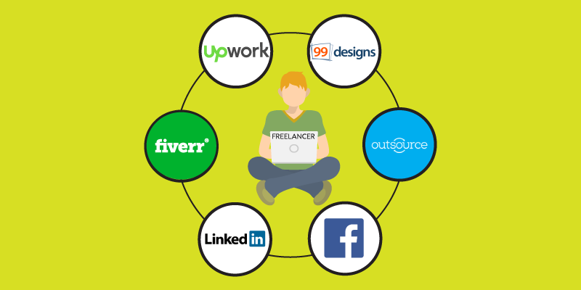
Example 3: The Virtual Company
Image, courtesy of YourStory.com
No physical office locations, all workers co-work or telework
Collaboration tools integrated highly into work streams
No salaried employees, 100% freelance, contract workers
Strong requirements for time, utilization management
Agile, goal driven freelance approach with rigorous metrics

Slide 9
Marketing & Positioning
What is your key marketing message, and how do you ensure it reaches your target market?

Slide 10





Why We Exist – Our Manifesto!

Slide 11
How Are We Different?
From creating your first project, to managing delivery of a large program, Inflectra products work out of the box with no need for customization or consulting, completely turnkey.
Best practices are baked-in, so you can focus on meeting your goals, not worrying about what is falling through the cracks.
Powerful, straightforward, and flexible, Inflectra’s products adapt to you: your methodology, your workflow, your toolchain, your reporting needs.

Slide 12



Focus on Three User Communities
Testers
Developers
Managers
We consider each of these three stakeholders groups when designing our products, so that everyone in teams can get the most out of our products.

Slide 13
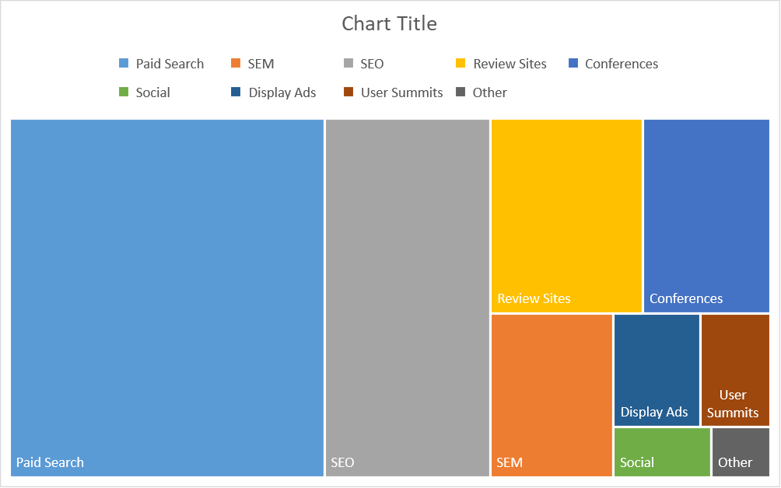
Marketing Methods – Getting the Message Out

Slide 14

Getting Social with Inflectra
Website – Blog, Support Forums
Twitter – Latest News & Info
Facebook – News & Industry
LinkedIn – In Depth Coverage
Google+ - Industry & Background
YouTube – Product Videos
Pinterest – Diagrams and Infographics
Instagram – People & Events
XING – Company news for DACH region
Meetup – Webinars and Local Events

Slide 15
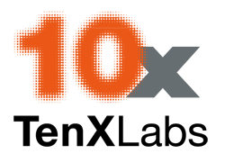























Solution Partner Network
We have an extensive worldwide network that is used to provide global consulting and training services as well as sales support:
North America
South America & Mexico
Asia
Europe
Australia
Middle East & Africa

Slide 16



Industry Partners
Industry partners provide unique solutions based on our products to handle specific use cases:
  ValidationMaster
  Provides medical validation solutions
  based on Inflectra platform
  USDM Life Sciences
  Provides life science innovation solutions
  based on Inflectra platform
  TX3 Compliance Solutions
  Regulatory Compliance Solutions
  based on SpiraTeam and Rapise

Slide 17
Inflectra Global Footprint
US Headquarters in Silver Spring, MD
Offshore Development in Moscow, Russia
Global Sales Offices:

Slide 18
Executing on Vision
In executing on your vision, in what one aspect have you excelled, and in what one aspect do you plan to improve?

Slide 19
One Aspect We Have Excelled
Developing a turnkey solution that has best practices built-in, yet is flexible and adaptable to customers’ needs.
For example, electronic signatures and workflows can be enabled for customers that need them, but don’t impede other users.
Customers report must faster implementation time using SpiraTeam than other less “opinionated” solutions (Jira, TFS)
  No need to configure process templates or add-ons

Slide 20
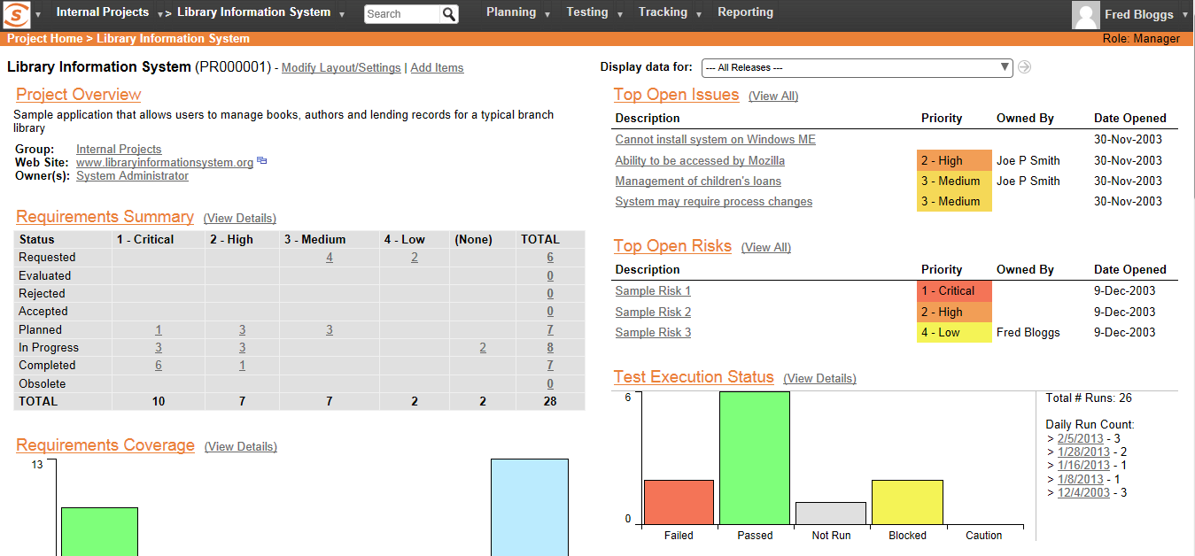
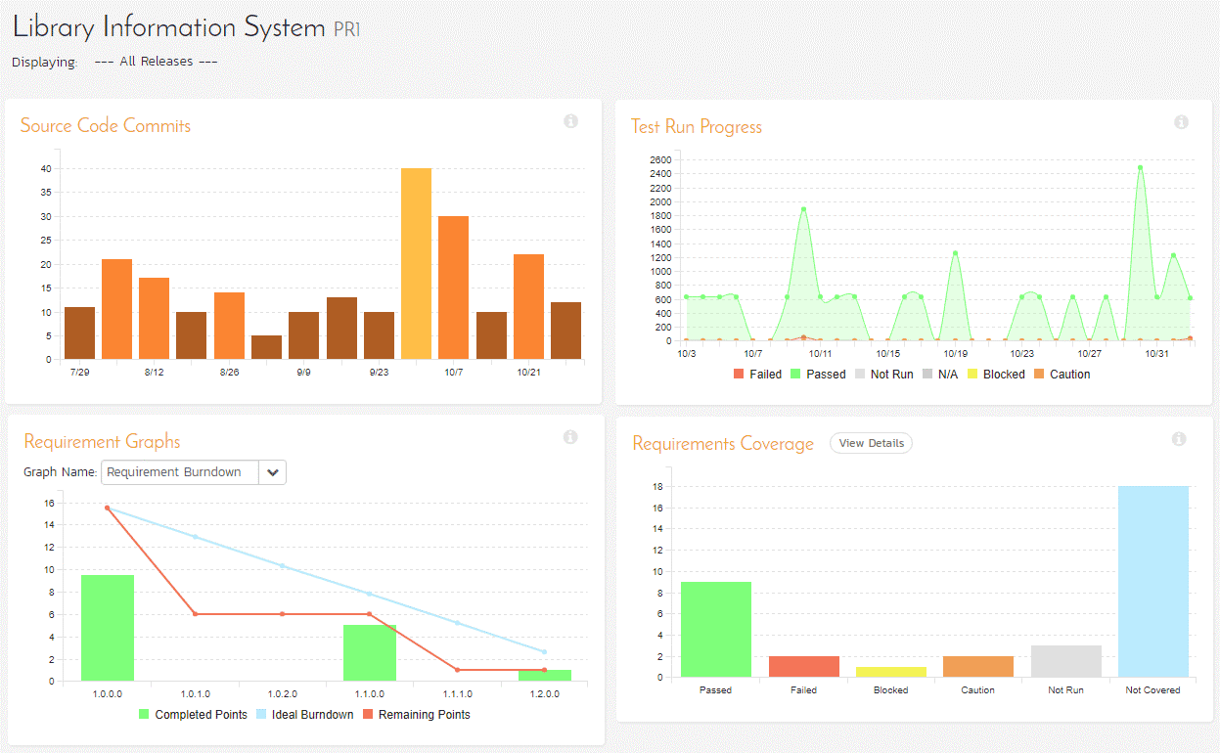
One Aspect We Plan to Improve
SpiraTeam was geared towards experienced users, we have simplified & streamlined the UI:
However we feel that there is still much scope for improvement…

Slide 21
Critical Capabilities
A live demonstration of the 5 Critical Capabilities in which your product is strongest

Slide 22
Critical Capabilities Demonstration
Backlog Management
Help build, groom, track and publicize backlogs. Includes the ability to track hierarchies of entries such as Themes, Epics and Stories.
Scrum Team Support
Provide a developer friendly way for scrum teams to find and track their stories.
Program / Portfolio level planning and tracking
Provide support for planning and tracking all of the work across a portfolio of several programs and many projects.
Integration with 3rd party Agile Planning Tools
Provide visibility to work being done using other vendors agile planning tools.
Visibility to stories through the DevOps toolchain
Ability to see in near-real time the status of a story from initiation through release.

Slide 23
Differentiated Use Cases
A live demonstration of the 2 Use Cases that most strongly differentiate your product

Slide 24
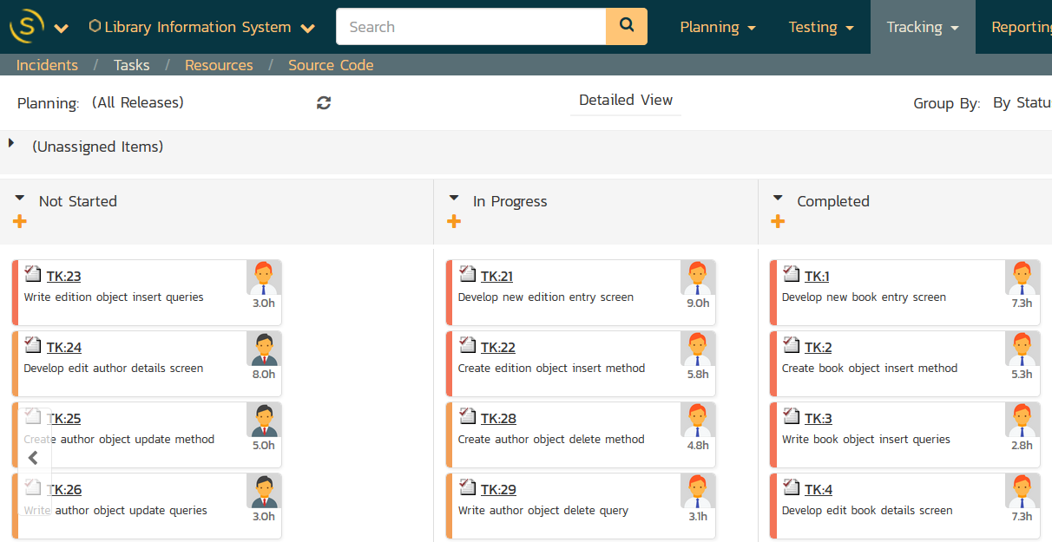
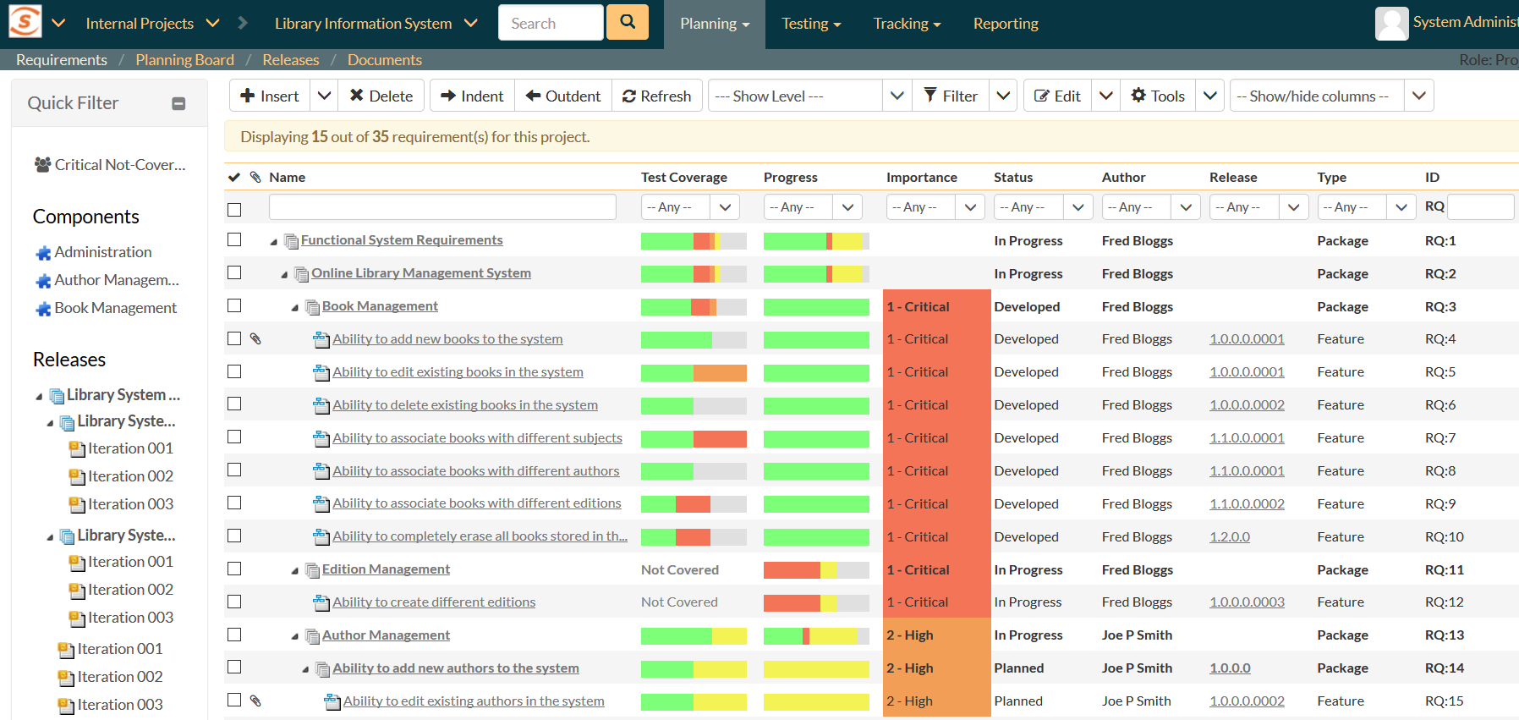
Mixed Methodologies
Tool is used to plan and track a set of teams doing a mix of two or more methodologies
  Agile vs waterfall
  Regulated vs. Unregulated
Blending iterative approach with upfront activities
Reporting across phases
Customizable processes
Explicit milestones and quality gates
Agile boards for Scrum, Kanban
Support for stories, use cases and traditional requirements
Exploratory testing (agile) and manual testing (waterfall)

Slide 25
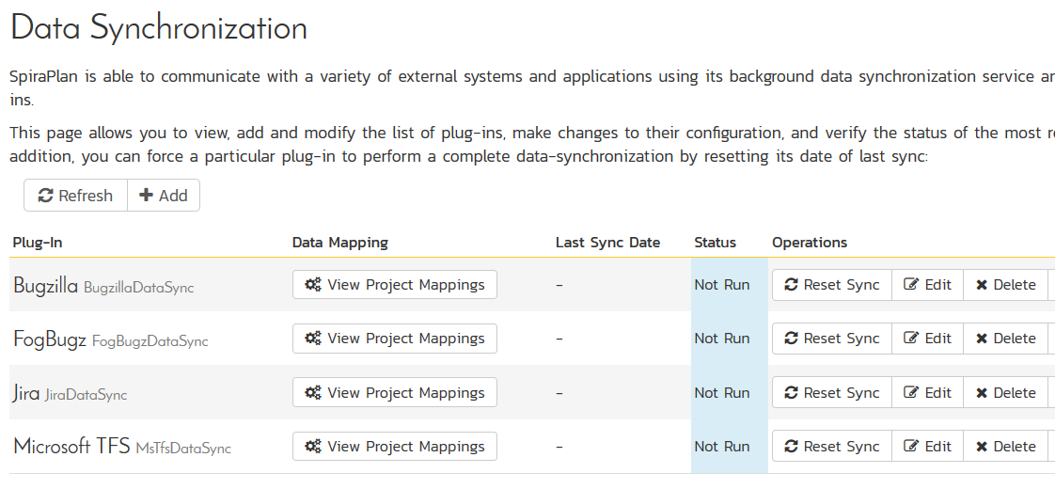
Outsource
Plan & track work across internal and outsourced teams
Mix of different agile tools, working in same portfolio
Visibility between teams
Different timezones & hours
Dev, QA, & Mgt Teams
Communication of requirements to Dev & QA
Data-synchronization framework
Multi-language, timezones
Concurrent licensing
Integrated QA Team Features
Enterprise instant messaging

Slide 26
Questions?

